Slide 1
Azure SQL Performance Tuning
Module 6

Slide 2
Learning Units covered in this Module
Lesson 1: Troubleshooting Azure SQL Performance with Query Performance Insights
Lesson 2: Automatic Tuning in Azure SQL
Lesson 3: Intelligent Query Processing

Slide 3
Lesson 1: Query Performance Insights

Slide 4

Objectives
After completing this learning, you will be able to:
Install the Query Performance Insights library
Troubleshoot performance issues with QPI

Slide 5
Objectives
After completing this learning, you will be able to:
Know how to troubleshoot the performance of your queries by using Query Performance Insight.
Notes:
This lesson covers Monitoring Query Performance using Query Performance Insight

Slide 6
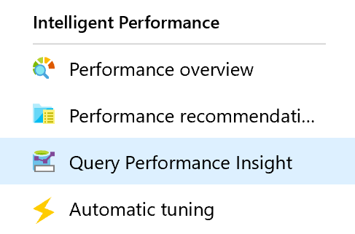
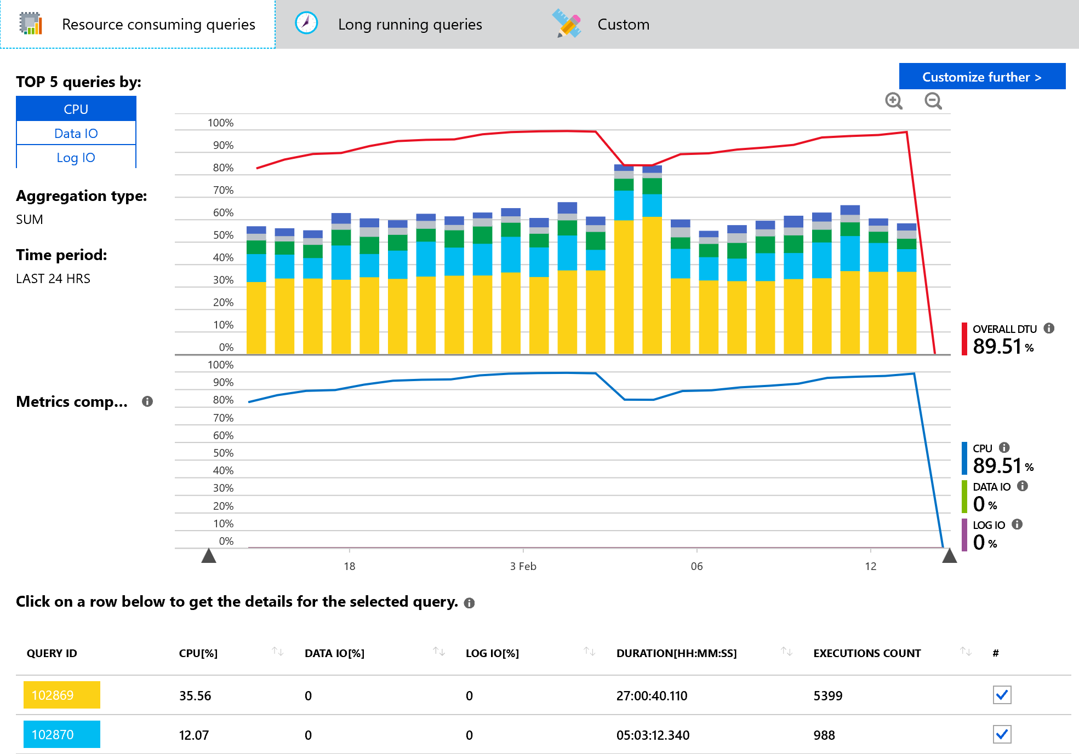
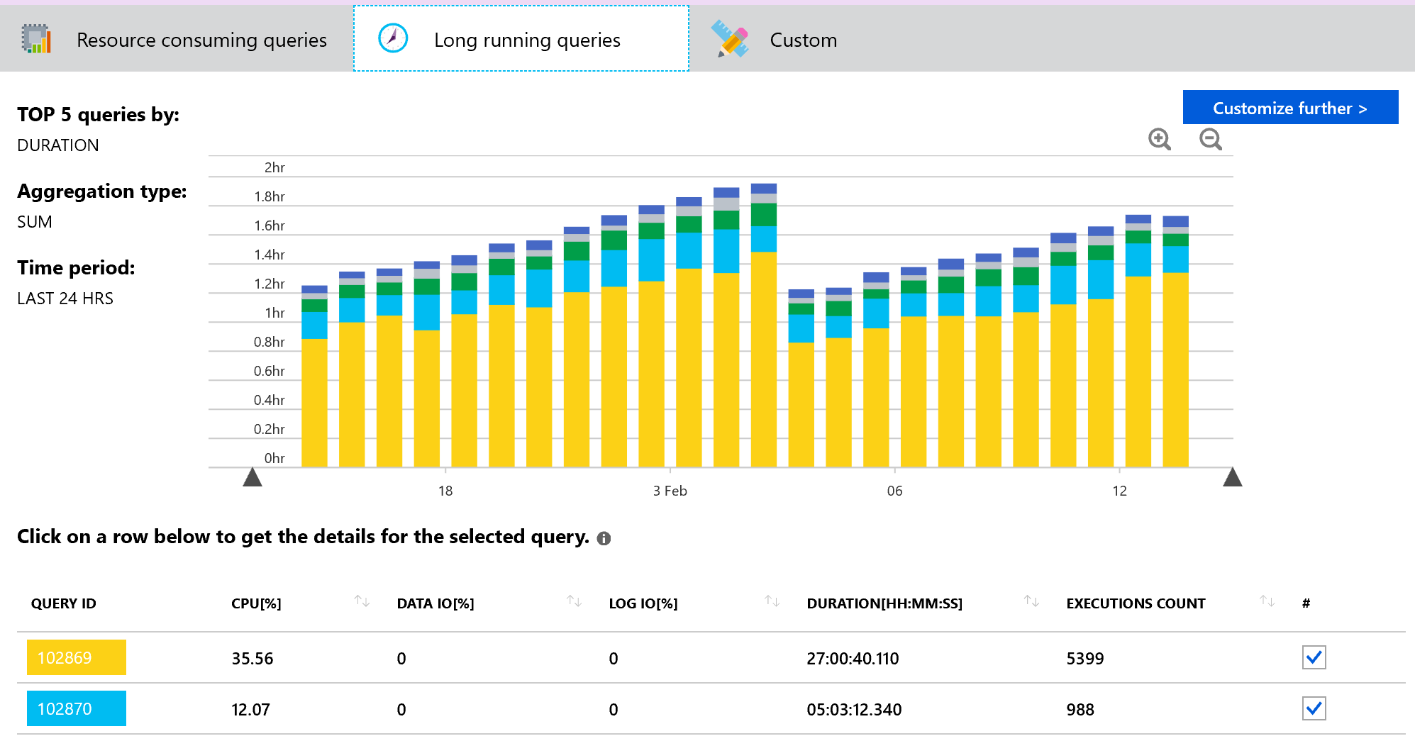
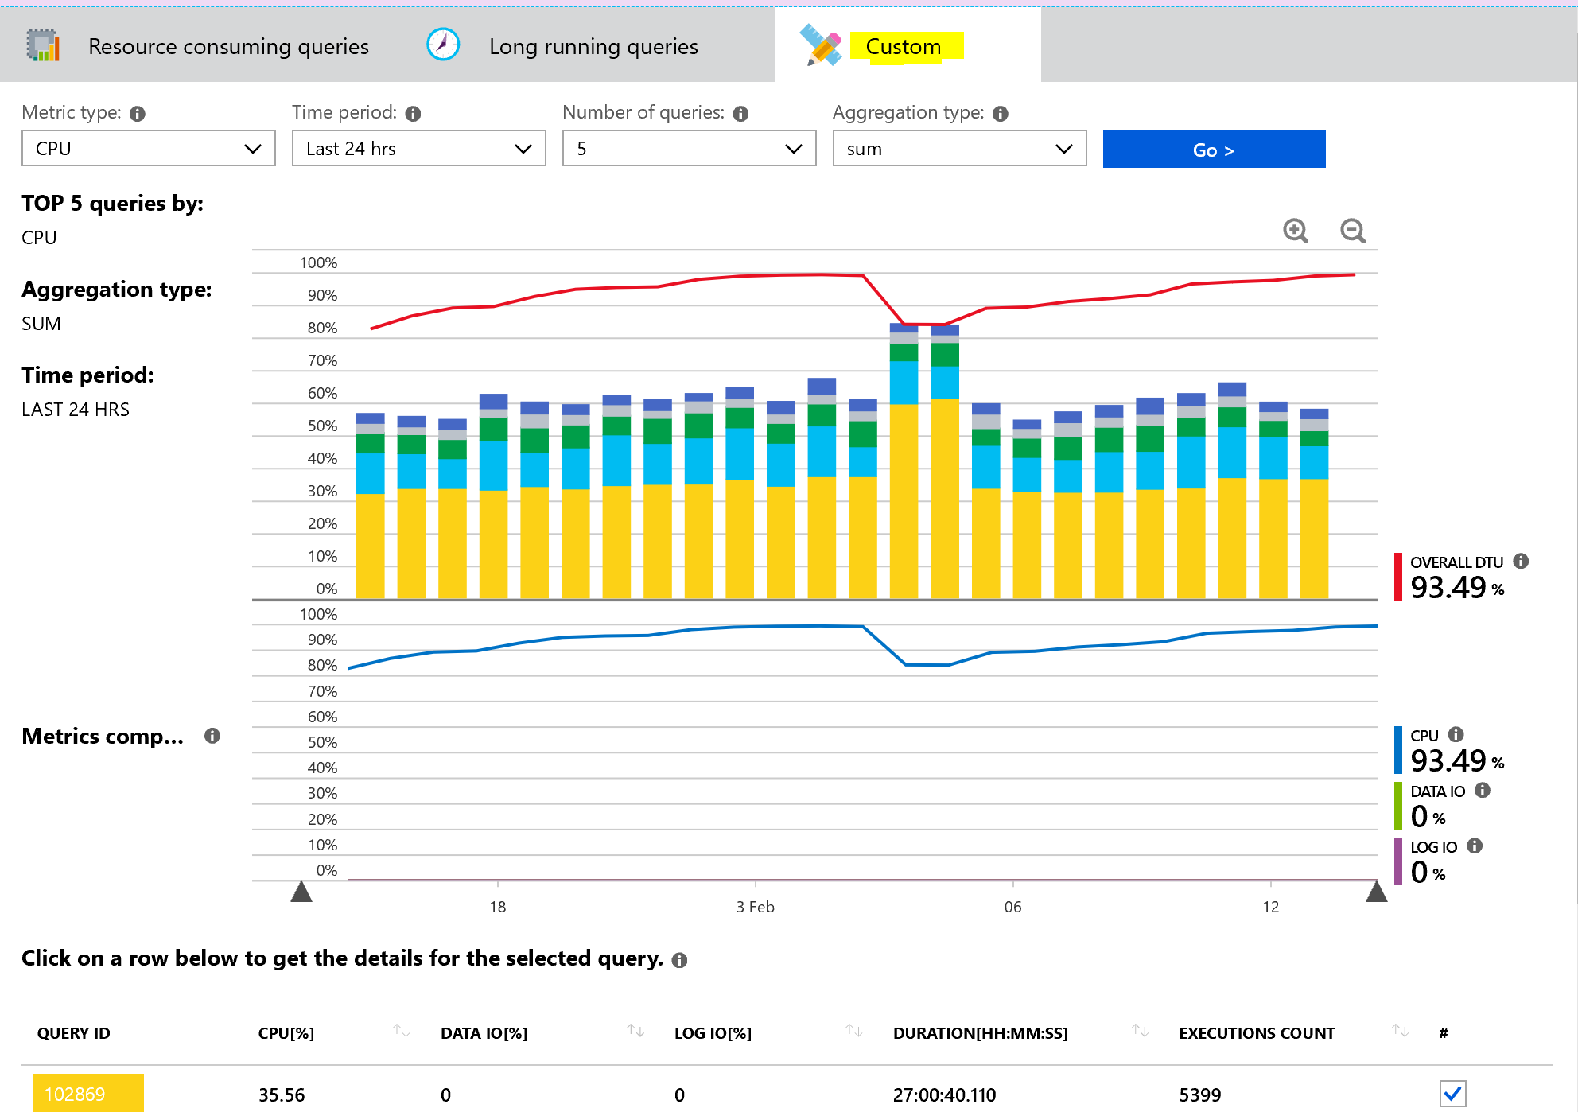
Query Performance Insight
Custom options – Insights based upon custom selection:
Metric Type – CPU , Data IO, Log IO, Duration and Execution Count.
Time Period – Last 6 hrs, Last 24 hrs, Past Week, Past Month and Custom.
Number of Queries – 5, 10, 20.
Aggregation type – sum, max and avg.
Query Performance Insight
Shows top performance degrading queries by showing most resource consuming queries, long running queries and custom configuration.
Can drill through the queries to see Query text, CPU, data IO and Log IO utilization %, Duration and Execution count.
Notes:
Managing and tuning the performance of relational databases is a challenging task that requires significant expertise and time investment. Query Performance Insight allows you to spend less time troubleshooting database performance by providing the following:+
Deeper insight into your databases resource (DTU) consumption.
The top queries by CPU/Duration/Execution count, which can potentially be tuned for improved performance.
The ability to drill down into the details of a query, view its text and history of resource utilization.
Performance tuning annotations that show actions performed by SQL Azure Database Advisor
Open Azure portal and find database that you want to examine.
From left-hand side menu, under support and troubleshooting, select “Query Performance Insight”.
On the first tab, review the list of top resource-consuming queries.
Select an individual query to view its details.
Open SQL Azure Database Advisor and check if any recommendations are available.
Use sliders or zoom icons to change observed interval.
The top line shows overall DTU% for the database, while the bars show CPU% consumed by the selected queries during the selected interval (for example, if Past week is selected each bar represents one day).
The bottom grid represents aggregated information for the visible queries.
Query ID - unique identifier of query inside database.
CPU per query during observable interval (depends on aggregation function).
Duration per query (depends on aggregation function).
Total number of executions for a particular query.

Slide 7
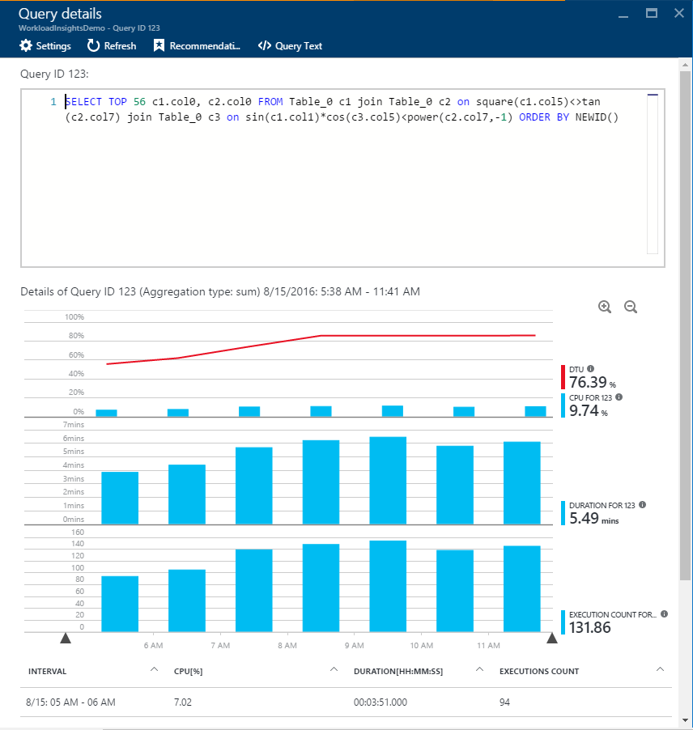
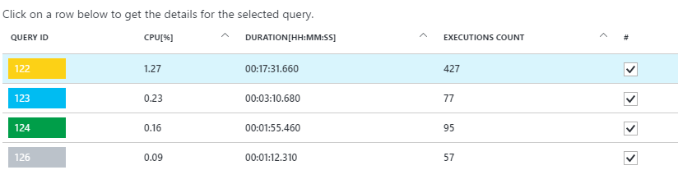
Viewing individual query details
Get details for the individual queries
CPU Consumption
Duration
Execution Count
It does not capture DDL queries
Notes:
Click any query in the list of top queries.
The details view opens and the queries CPU consumption/Duration/Execution count is broken down over time.
Click around the chart for details.
Top chart shows line with overall database DTU%, and the bars are CPU% consumed by the selected query.
Second chart shows total duration by the selected query.
Bottom chart shows total number of executions by the selected query.

Slide 8
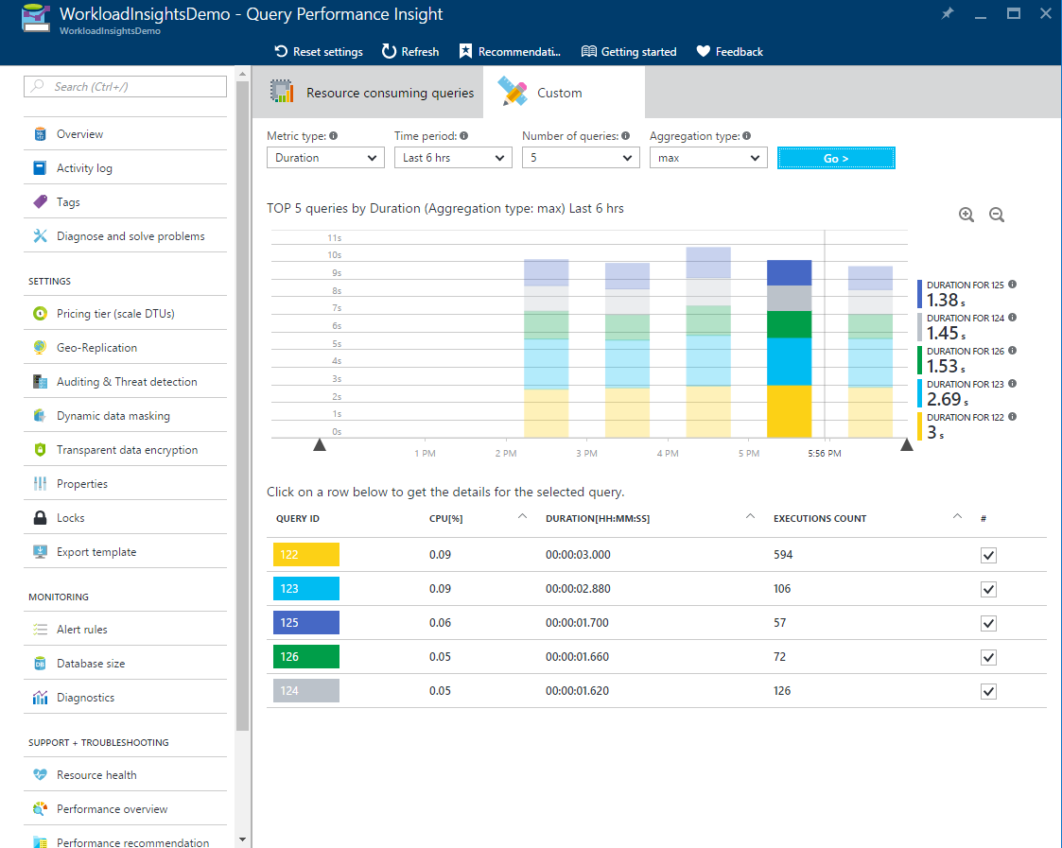
Review top queries per duration
Duration is one of the metrics showing potential bottleneck
Long-running queries has potential for:
Longer locks
Blocking other users
Limiting scalability
Notes:
In the recent update of Query Performance Insight, we introduced two new metrics that can help you identify potential bottlenecks: duration and execution count.
Long-running queries have the greatest potential for locking resources longer, blocking other users, and limiting scalability. They are also the best candidates for optimization.
Open Custom tab in Query Performance Insight for selected database
Change metrics to be duration

Slide 9
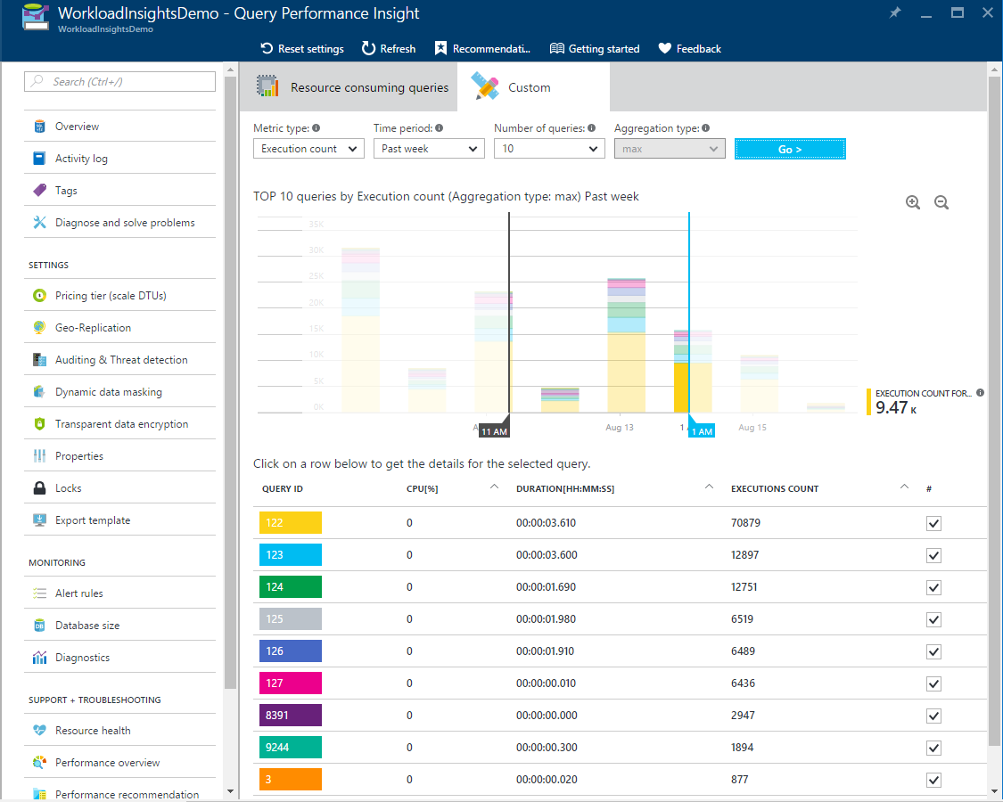
Review top queries per execution count
Execution count is one of the metrics showing potential bottleneck
High number og executions has potential for:
Database performance
Network latency
Downstream server latency
Notes:
High number of executions might not be affecting database itself and resources usage can be low, but overall application might get slow.+
In some cases, very high execution count may lead to increase of network round trips. Round trips significantly affect performance. They are subject to network latency and to downstream server latency.
For example, many data-driven Web sites heavily access the database for every user request. While connection pooling helps, the increased network traffic and processing load on the database server can adversely affect performance. General advice is to keep round trips to an absolute minimum.+
To identify frequently executed queries (“chatty”) queries:+
Open Custom tab in Query Performance Insight for selected database
Change metrics to be execution count

Slide 10

Demonstration
Query Performance Insight
Analyze the Query Performance Insight output.
Notes:
M05L02Demo01
Demo Requirements
Salesdb that was created in module 1
Use the script C:\Demos\M05L02Demo01\Workload.sql.
Make sure that you have already created and populated the table because this takes a few minutes to complete
SSMS
Steps:
Open your SSMS, connect to your logical server
Right click on the salesdb and select Properties → Query Store
Change the following settings:
Data Flush Interval → 1min
Statistics Collection Interval → 1 Minute
Click on “Purge Query Data” to empty the Query Store
Open the Workload.sql file and execute the stored procedure
EXEC dbo.proc_Emp_search 123
GO 20
EXEC dbo.proc_Emp_search 121023
GO 20
6. Create the non-clustered index and execute the stored procedure EXEC dbo.proc_Emp_search 123 again
7. Wait for 1 minute so that the query store can collect the execution times and the Query plans. You should see 2 query plans for the same query
8. Open the Azure Portal, go to the salesdb and click on Query Performance Insight
9. The query of the stored procedure should be available.
10. Show the dashboard of the resource consuming query and click on the query to drill down in more execution statistics of the query
11. Go back to the Object Explorer of SSMS → Query store → Top Resource Consuming Queries
12. Show the different option of the query store and also show that there are 2 different query plans for the same query.

Slide 11

Questions?

Slide 12
Lesson 2: Azure SQL Automatic Tuning
Notes:
This lesson covers the Azure SQL Database Tuning using Automatic Tuning

Slide 13
Objectives
After completing this learning, you will be able to:
Know how Performance Recommendations can help to improve database performance.
Notes:
This lesson covers the Azure SQL Database Tuning using Automatic Tuning

Slide 14
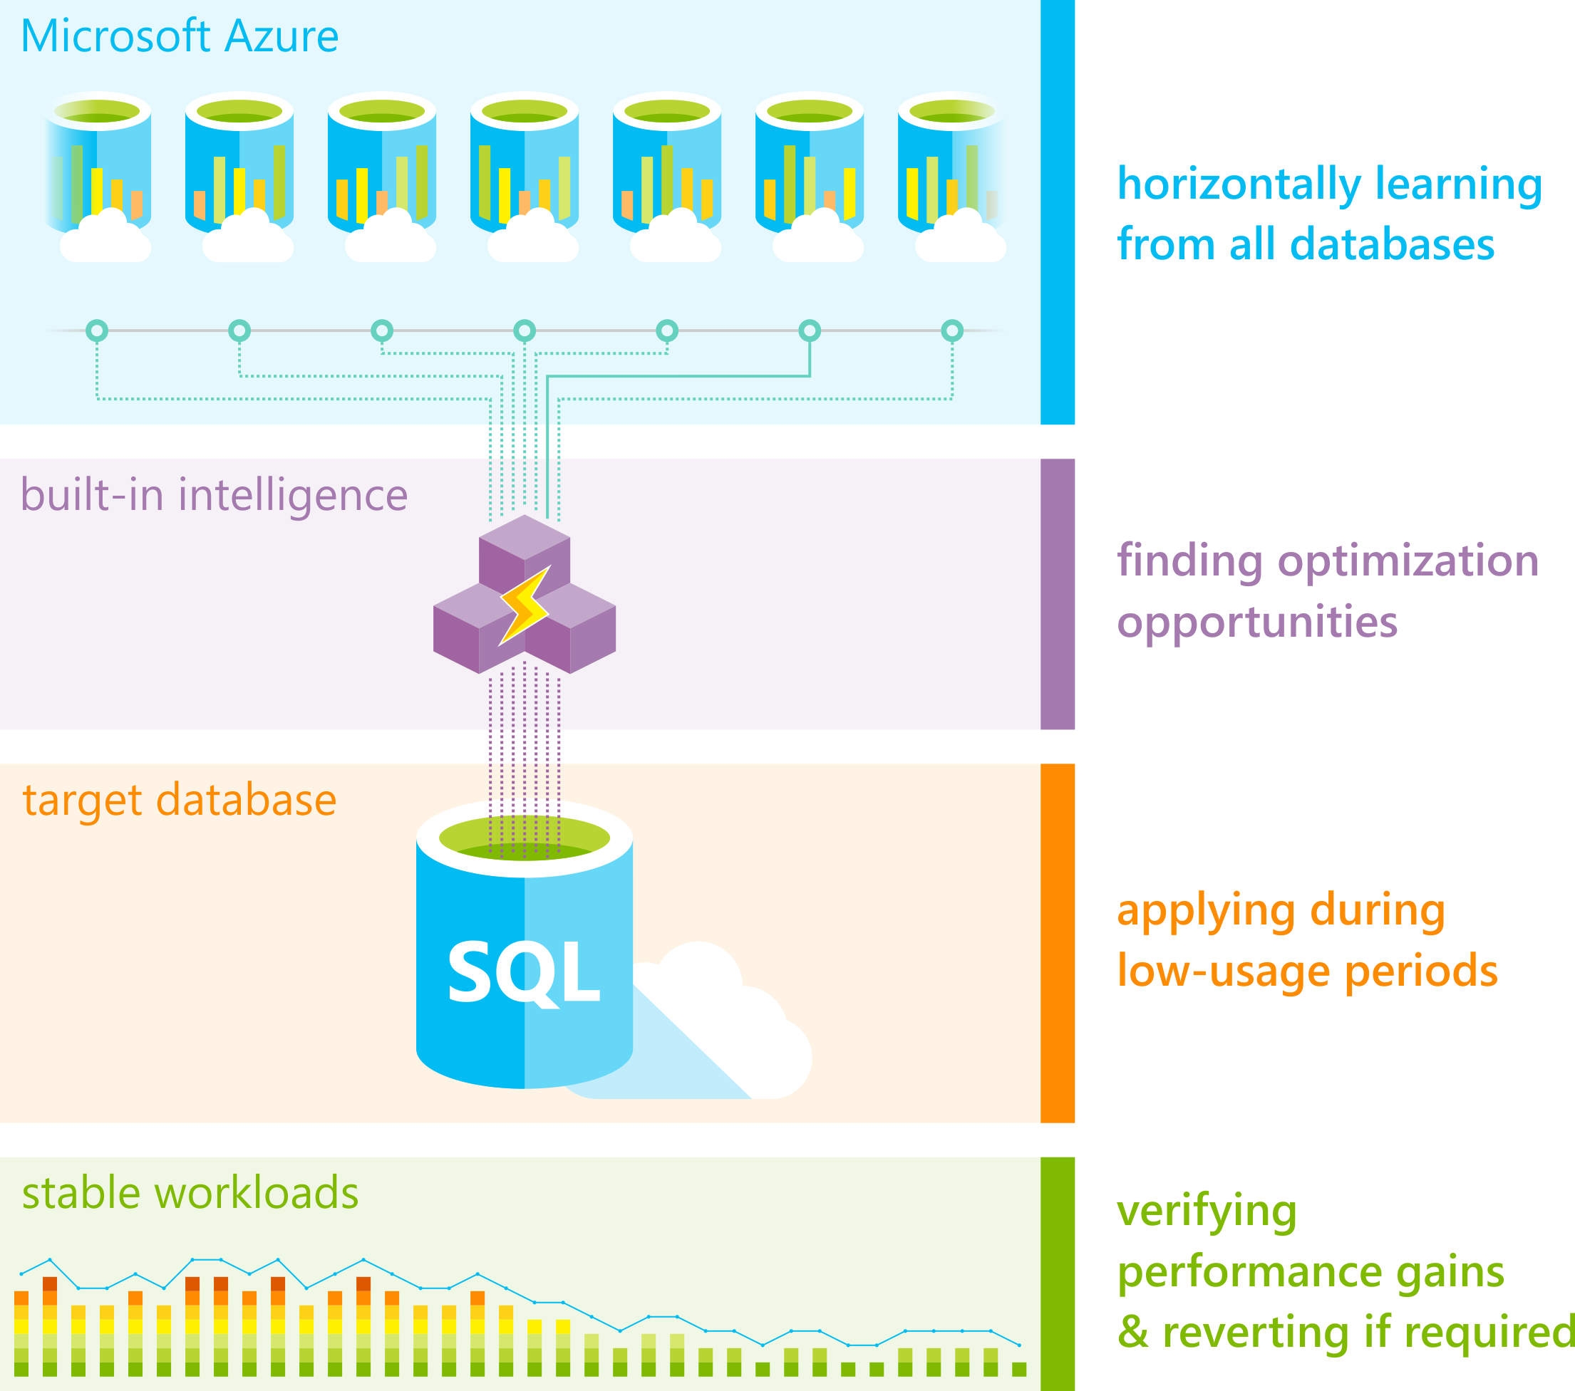
Automatic Tuning
Performance recommendations for SQL Database
Notes:
Azure SQL Database Automatic tuning provides peak performance and stable workloads through continuous performance tuning utilizing Artificial Intelligence.
Automatic tuning is a fully managed service that uses built-in intelligence to continuously monitor queries executed on a database and it automatically improves their performance. This is achieved through dynamically adapting database to the changing workloads and applying tuning recommendations. Automatic tuning learns horizontally from all databases on Azure through Artificial Intelligence and it dynamically improves its tuning actions. The longer an Azure SQL Database runs with automatic tuning on, the better it performs.
Azure SQL Database Automatic tuning might be one of the most important features that you can enable to provide stable and peak performing workloads.
Tuning operations applied to Azure SQL Databases are fully safe for the performance of your most intense workloads. The system has been designed with care not to interfere with the user workloads. Automated tuning recommendations are applied only at the times of a low utilization. The system can also temporarily disable automatic tuning operations to protect the workload performance. In such case, “Disabled by the system” message will be shown in Azure portal. Automatic tuning regards workloads with the highest resource priority.
Automatic tuning mechanisms are mature and have been perfected on hundreds of thousands of databases running on Azure. Automated tuning operations applied are verified automatically to ensure there is a positive improvement to the workload performance. Regressed performance recommendations are dynamically detected and promptly reverted. Through the tuning history log there is a clear trace of tuning improvements made to each Azure SQL Database.
Automatic tuning options available in Azure SQL Database are:
CREATE INDEX - identifies indexes that may improve performance of your workload, creates indexes, and automatically verifies that performance of queries has improved.
DROP INDEX - identifies redundant and duplicate indexes, and indexes that were not used for a very long period of time. Please note that this option is not compatible with applications using partition switching and index hints.
FORCE LAST GOOD PLAN - identifies SQL queries using execution plan that is slower than the previous good plan, and queries using the last known good plan instead of the regressed plan.

Slide 15
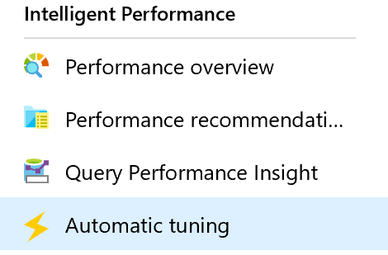
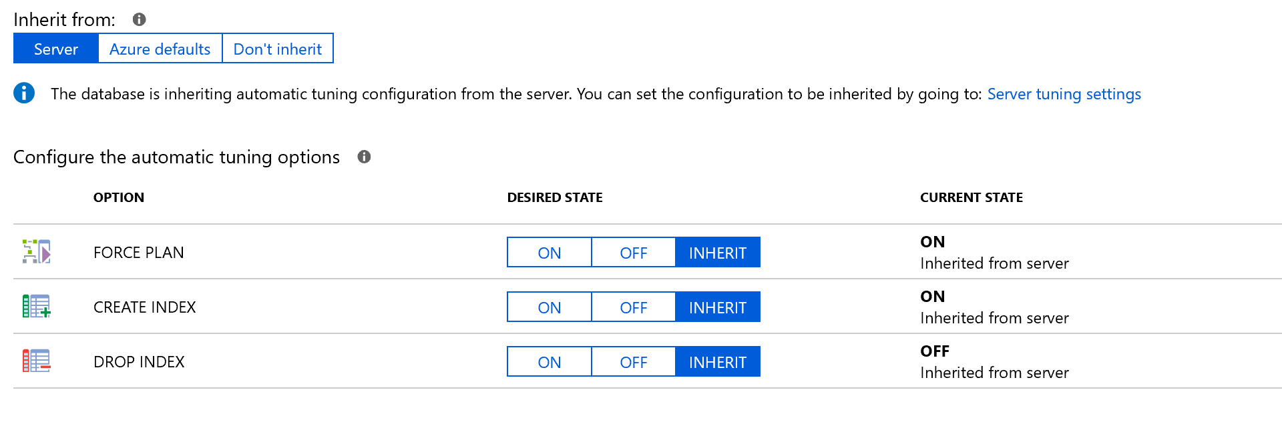
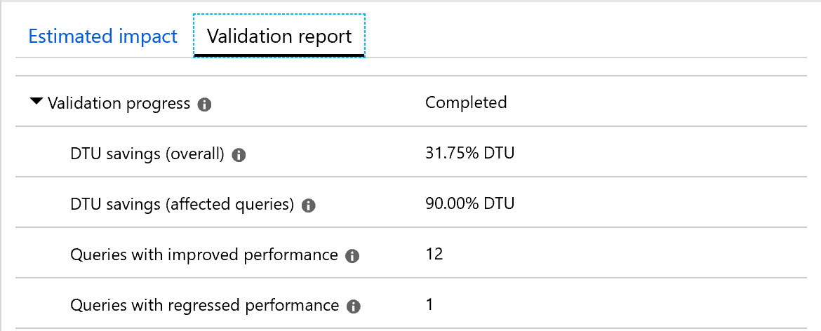
Intelligent Performance – Automatic Tuning
Force Last Good Plan:
Identifies and creates Indexes, validates performance improvements and reverts the change if performance degrades.
Drop Index:
Identifies and drops unused Indexes, validates performance improvements and reverts the change if performance degrades.
Identifies regressed queries due to bad plan and replaces the bad plan with last Good Plan, validates performance improvements and reverts the change if performance does not improve.
Create Index:
http://automaticplancorrectiondemo.azurewebsites.net/index.html

Slide 16
Automatic Tuning – Create Index
SQL Database monitors the queries
Identifies indexes that could improve performance
Creates an index recommendation (high, medium or low)
Apply the index recommendation
Compare the performance with the baseline
If performance improved?
Revert OR
Flagged as successful
Notes:
Create index recommendations
SQL Database continuously monitors the queries that are running and identifies the indexes that could improve performance. After there's enough confidence that a certain index is missing, a new Create index recommendation is created.
Azure SQL Database builds confidence by estimating the performance gain the index would bring through time. Depending on the estimated performance gain, recommendations are categorized as high, medium, or low.
Indexes that are created by using recommendations are always flagged as auto-created indexes. You can see which indexes are auto-created by looking at the sys.indexes view. Auto-created indexes don’t block ALTER/RENAME commands.
If you try to drop the column that has an auto-created index over it, the command passes. The auto-created index is dropped with the command as well. Regular indexes block the ALTER/RENAME command on columns that are indexed.
After the create index recommendation is applied, Azure SQL Database compares the performance of the queries with the baseline performance. If the new index improved performance, the recommendation is flagged as successful and the impact report is available. If the index didn’t improve performance, it's automatically reverted. SQL Database uses this process to ensure that recommendations improve database performance.
Any create index recommendation has a back-off policy that doesn't allow applying the recommendation if the resource usage of a database or pool is high. The back-off policy takes into account CPU, Data IO, Log IO, and available storage.
If CPU, Data IO, or Log IO is higher than 80% in the previous 30 minutes, the create index recommendation is postponed. If the available storage will be below 10% after the index is created, the recommendation goes into an error state. If, after a couple of days, automatic tuning still believes that the index would be beneficial, the process starts again.
This process repeats until there's enough available storage to create an index, or until the index isn't seen as beneficial anymore.

Slide 17
Automatic Tuning – Drop Index
Is an index not used
Drop index recommendation
Apply the index recommendation
Compare the performance with the baseline
If performance improved?
Revert OR
Flagged as successful
Notes:
Drop index recommendations
Besides detecting missing indexes, SQL Database continuously analyzes the performance of existing indexes. If an index is not used, Azure SQL Database recommends dropping it. Dropping an index is recommended in two cases:
The index is a duplicate of another index (same indexed and included column, partition schema, and filters).
The index hasn't been used for a prolonged period (93 days).
Drop index recommendations also go through the verification after implementation. If the performance improves, the impact report is available. If performance degrades, the recommendation is reverted.

Slide 18
Automatic Tuning – Parameterize Queries
Queries that are constantly being recompiled but end up with the same query execution plan
Forced parameterization
Apply the recommendation
Compare the performance with the baseline
If performance improved?
Revert OR
Flagged as successful
Notes:
Parameterize queries recommendations
Parameterize queries recommendations appear when you have one or more queries that are constantly being recompiled but end up with the same query execution plan. This condition creates an opportunity to apply forced parameterization. Forced parameterization, in turn, allows query plans to be cached and reused in the future, which improves performance and reduces resource usage.
Every query that's issued against SQL Server initially needs to be compiled to generate an execution plan. Each generated plan is added to the plan cache. Subsequent executions of the same query can reuse this plan from the cache, which eliminates the need for additional compilation.
Queries with non-parameterized values can lead to performance overhead because the execution plan is recompiled each time the non-parameterized values are different. In many cases, the same queries with different parameter values generate the same execution plans. These plans, however, are still separately added to the plan cache.
The process of recompiling execution plans uses database resources, increases the query duration time, and overflows the plan cache. These events, in turn, cause plans to be evicted from the cache. This SQL Server behavior can be altered by setting the forced parameterization option on the database.
To help you estimate the impact of this recommendation, you are provided with a comparison between the actual CPU usage and the projected CPU usage (as if the recommendation were applied). This recommendation can help you gain CPU savings. It can also help you decrease query duration and overhead for the plan cache, which means that more of the plans can stay in the cache and be reused. You can apply this recommendation quickly by selecting the Apply command.
After you apply this recommendation, it enables forced parameterization within minutes on your database. It starts the monitoring process, which lasts for approximately 24 hours. After this period, you can see the validation report. This report shows the CPU usage of your database 24 hours before and after the recommendation has been applied. SQL Database Advisor has a safety mechanism that automatically reverts the applied recommendation if performance regression has been detected.

Slide 19
Questions?

Slide 20
Lesson 3: Intelligent Query Processing
Notes:
This lesson covers the Azure SQL Database Tuning using Automatic Tuning

Slide 21
What is in the lesson?
A History of Intelligent Query Processing?
Intelligent Query Processing (2019)
Adaptive Query Processing (2017)
New Features of IQP (2022)
Enabling and Disabling Features

Slide 22


In a World… before IQP
Legacy CE
Updated CE
Notes:
Versions of the CE
In 1998, a major update of the CE was part of SQL Server 7.0, for which the compatibility level was 70. This version of the CE model is set on four basic assumptions:
Independence: Data distributions on different columns are assumed to be independent of each other, unless correlation information is available and usable.
Uniformity: Distinct values are evenly spaced and that they all have the same frequency. More precisely, within each histogram step, distinct values are evenly spread and each value has same frequency.
Containment (Simple): Users query for data that exists. For example, for an equality join between two tables, factor in the predicates selectivity¹ in each input histogram, before joining histograms to estimate the join selectivity.
Inclusion: For filter predicates where Column = Constant, the constant is assumed to actually exist for the associated column. If a corresponding histogram step is non-empty, one of the step's distinct values is assumed to match the value from the predicate.
¹ Row count that satisfies the predicate.
Subsequent updates started with SQL Server 2014 (12.x), meaning compatibility levels 120 and above. The CE updates for levels 120 and above incorporate updated assumptions and algorithms that work well on modern data warehousing and on OLTP workloads. From the CE 70 assumptions, the following model assumptions were changed starting with CE 120:
Independence becomes Correlation: The combination of the different column values are not necessarily independent. This may resemble more real-life data querying.
Simple Containment becomes Base Containment: Users might query for data that does not exist. For example, for an equality join between two tables, we use the base tables histograms to estimate the join selectivity, and then factor in the predicates selectivity.
Parameter-sensitive? GLOBAL query
GLOBAL: Do not capitalize generic terms. Please note that we do not capitalize terms unless they are from the UI or are feature or product names. Please consider lowercasing such terms throughout this document.
GLOBAL: Please avoid using first person (“we”, “I”) Always use “you” or “Microsoft” if that is applicable.
…have a lot of …?

Slide 23
Adaptive Query Processing (2017)
Interleaved Execution
Memory Grant Feedback
Adaptive Joins
Adaptive Query Processing
Batch Mode
Notes:
https://docs.microsoft.com/en-us/sql/relational-databases/performance/intelligent-query-processing?view=sql-server-ver16
Parameter-sensitive? GLOBAL query
GLOBAL: Do not capitalize generic terms. Please note that we do not capitalize terms unless they are from the UI or are feature or product names. Please consider lowercasing such terms throughout this document.
GLOBAL: Please avoid using first person (“we”, “I”) Always use “you” or “Microsoft” if that is applicable.
…have a lot of …?

Slide 24
Intelligent Query Processing (2019)
Interleaved Execution
Memory Grant Feedback
Adaptive Joins
Intelligent Query Processing
Adaptive Query Processing
Batch Mode
Row Mode
Table Variable Deferred Compilation
Batch Mode On Rowstore Indexes
Scalar UDF Inlining
Approximate Query Processing
Approximate Count Distinct
Azure SQL Database
http://aka.ms/IQP
SQL Server 2017
SQL Server 2019
Notes:
Parameter-sensitive? GLOBAL query
GLOBAL: Do not capitalize generic terms. Please note that we do not capitalize terms unless they are from the UI or are feature or product names. Please consider lowercasing such terms throughout this document.
GLOBAL: Please avoid using first person (“we”, “I”) Always use “you” or “Microsoft” if that is applicable.
…have a lot of …?

Slide 25
Intelligent Query Processing (2022)
Interleaved Execution
Adaptive Joins
Intelligent Query Processing
Adaptive Query Processing
Batch Mode
Feedback Persistence
Table Variable Deferred Compilation
Batch Mode On Rowstore Indexes
Scalar UDF Inlining
Approximate Query Processing
Approximate Count Distinct
Memory Grant Feedback
Row Mode
Approximate Percentile
Parameter Sensitive Plan Optimization
CE Feedback
DOP Feedback
Optimized Plan Forcing
Azure SQL Database
2017
2019
2022
Notes:
Parameter-sensitive? GLOBAL query
GLOBAL: Do not capitalize generic terms. Please note that we do not capitalize terms unless they are from the UI or are feature or product names. Please consider lowercasing such terms throughout this document.
GLOBAL: Please avoid using first person (“we”, “I”) Always use “you” or “Microsoft” if that is applicable.
…have a lot of …?

Slide 26
Enabling and Disabling – Instance Level
For SQL Server 2017 Features
Enabled by default in Compatibility level 140 or higher
To disable change compatibility level to 130 or lower
For SQL Server 2019 Features
Enabled by default in Compatibility level 150 or higher
To disable change compatibility level to 140 or lower
For SQL Server 2022 Features
Enabled by default in Compatibility level 160 or higher
To disable change compatibility level to 150 or lower
Notes:
Parameter-sensitive? GLOBAL query
GLOBAL: Do not capitalize generic terms. Please note that we do not capitalize terms unless they are from the UI or are feature or product names. Please consider lowercasing such terms throughout this document.
GLOBAL: Please avoid using first person (“we”, “I”) Always use “you” or “Microsoft” if that is applicable.
…have a lot of …?

Slide 27
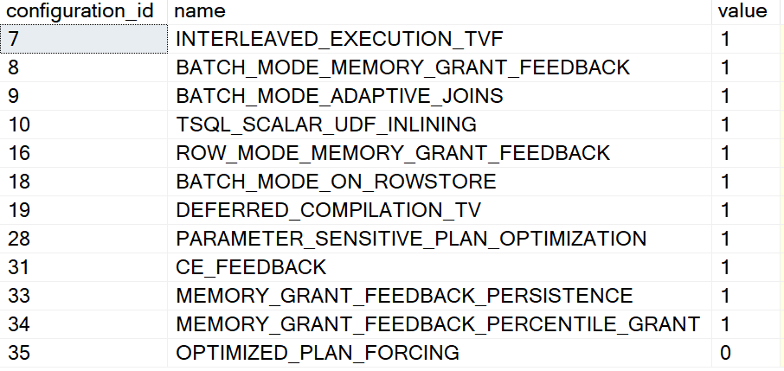
Enabling and Disabling – Database Level
Different settings for 2017 vs Azure SQL, SQL Server 2019 and higher
ALTER DATABASE SCOPED CONFIGURATION SET DISABLE_BATCH_MODE_ADAPTIVE_JOINS = ON|OFF;
ALTER DATABASE SCOPED CONFIGURATION SET BATCH_MODE_ADAPTIVE_JOINS = ON|OFF;
To get a list of Database Scoped Configuration settings
SELECT * From sys.database_scoped_configurations;
Notes:
Parameter-sensitive? GLOBAL query
GLOBAL: Do not capitalize generic terms. Please note that we do not capitalize terms unless they are from the UI or are feature or product names. Please consider lowercasing such terms throughout this document.
GLOBAL: Please avoid using first person (“we”, “I”) Always use “you” or “Microsoft” if that is applicable.
…have a lot of …?

Slide 28
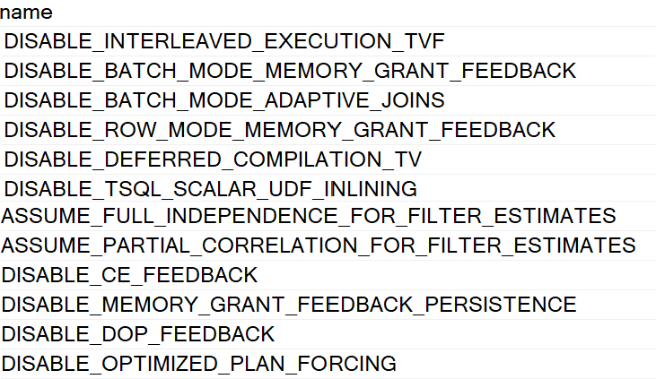
Enabling and Disabling – Statement Level
You can disable features at the statement scope if necessary.
<statement>
OPTION (USE HINT('DISABLE_BATCH_MODE_ADAPTIVE_JOINS'));
To get a list of valid query use hints
SELECT * FROM sys.dm_exec_valid_use_hints;
Notes:
Parameter-sensitive? GLOBAL query
GLOBAL: Do not capitalize generic terms. Please note that we do not capitalize terms unless they are from the UI or are feature or product names. Please consider lowercasing such terms throughout this document.
GLOBAL: Please avoid using first person (“we”, “I”) Always use “you” or “Microsoft” if that is applicable.
…have a lot of …?

Slide 29
Intelligent Query Processing
Interleaved Execution
Adaptive Joins
Intelligent Query Processing
Adaptive Query Processing
Batch Mode
Feedback Persistence
Table Variable Deferred Compilation
Batch Mode On Rowstore Indexes
Scalar UDF Inlining
Approximate Query Processing
Approximate Count Distinct
Memory Grant Feedback
Row Mode
Approximate Percentile
Parameter Sensitive Plan Optimization
CE Feedback
DOP Feedback
Optimized Plan Forcing
Azure SQL Database
2017
2019
2022
Notes:
Parameter-sensitive? GLOBAL query
GLOBAL: Do not capitalize generic terms. Please note that we do not capitalize terms unless they are from the UI or are feature or product names. Please consider lowercasing such terms throughout this document.
GLOBAL: Please avoid using first person (“we”, “I”) Always use “you” or “Microsoft” if that is applicable.
…have a lot of …?

Slide 30
Adaptive Query Processing (2017)
Interleaved Execution
Memory Grant Feedback
Adaptive Joins
Adaptive Query Processing
Batch Mode
Addresses performance issues related to the cardinality estimation of an execution plan.
These options can provide improved join type selection, row-calculations for Multi-Statement Table-Valued Functions, and memory allocation of row storage.
Notes:
Parameter-sensitive? GLOBAL query
GLOBAL: Do not capitalize generic terms. Please note that we do not capitalize terms unless they are from the UI or are feature or product names. Please consider lowercasing such terms throughout this document.
GLOBAL: Please avoid using first person (“we”, “I”) Always use “you” or “Microsoft” if that is applicable.
…have a lot of …?

Slide 31
Batch Mode Adaptive Joins (2017)
Interleaved Execution
Memory Grant Feedback
Adaptive Joins
Adaptive Query Processing
Batch Mode
This feature enables the choice of either the Hash or the Nested Loop join type.
Decision is deferred until statement execution.
No need to use join hints in queries.
Notes:
Parameter-sensitive? GLOBAL query
GLOBAL: Do not capitalize generic terms. Please note that we do not capitalize terms unless they are from the UI or are feature or product names. Please consider lowercasing such terms throughout this document.
GLOBAL: Please avoid using first person (“we”, “I”) Always use “you” or “Microsoft” if that is applicable.
…have a lot of …?

Slide 32
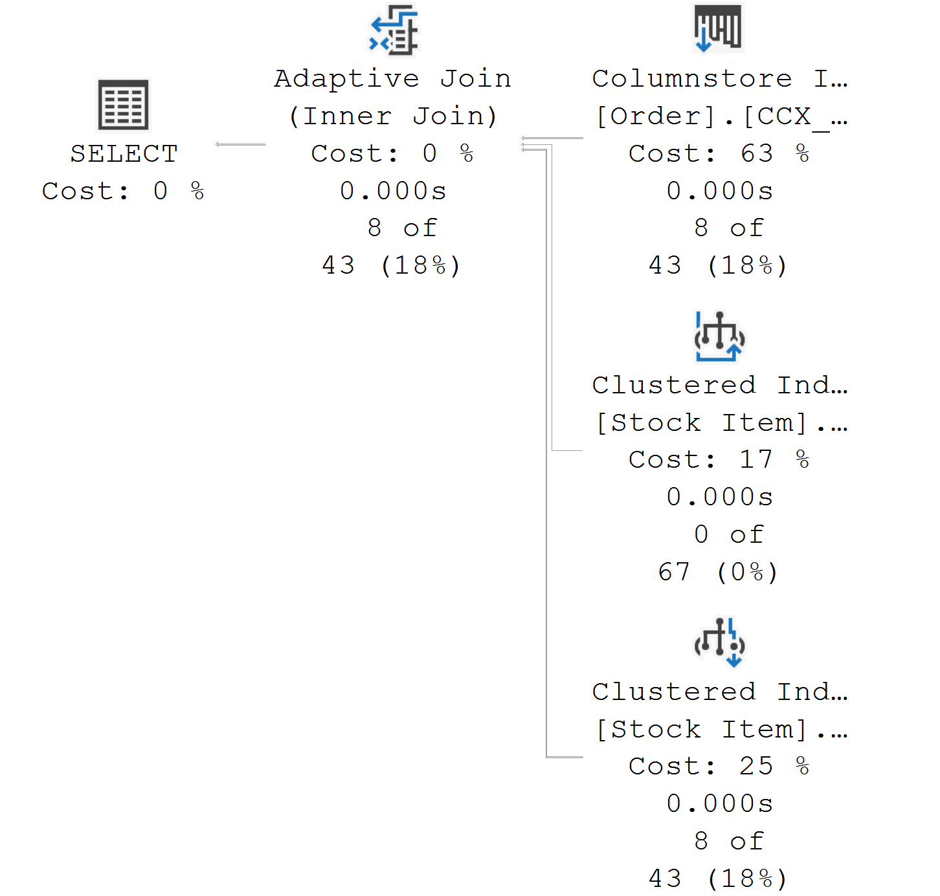
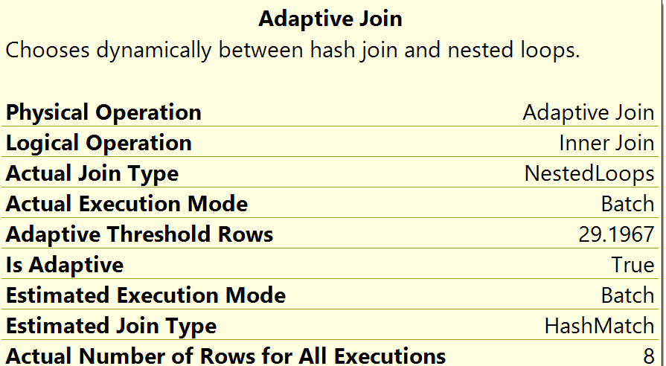
Batch Mode Adaptive Joins (2017)
Adaptive Joins
Notes:
Parameter-sensitive? GLOBAL query
GLOBAL: Do not capitalize generic terms. Please note that we do not capitalize terms unless they are from the UI or are feature or product names. Please consider lowercasing such terms throughout this document.
GLOBAL: Please avoid using first person (“we”, “I”) Always use “you” or “Microsoft” if that is applicable.
…have a lot of …?

Slide 33
Interleaved Execution (2017)
Interleaved Execution
Memory Grant Feedback
Adaptive Joins
Adaptive Query Processing
Batch Mode
Previously, when a Multi-Statement Table-Valued Function was executed, it used a fixed row estimate of 100 rows.
Now execution is paused so a better cardinality estimate can be captured.
Notes:
Parameter-sensitive? GLOBAL query
GLOBAL: Do not capitalize generic terms. Please note that we do not capitalize terms unless they are from the UI or are feature or product names. Please consider lowercasing such terms throughout this document.
GLOBAL: Please avoid using first person (“we”, “I”) Always use “you” or “Microsoft” if that is applicable.
…have a lot of …?

Slide 34
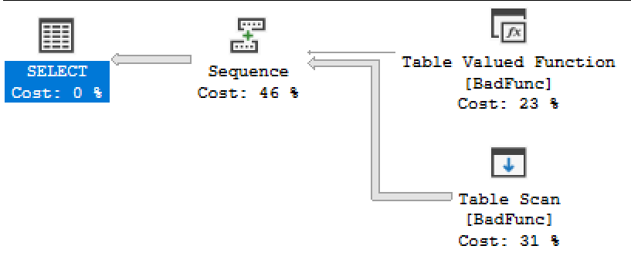
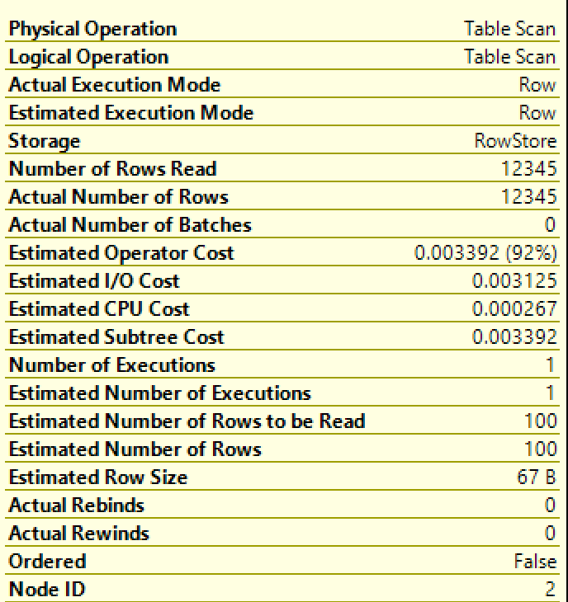
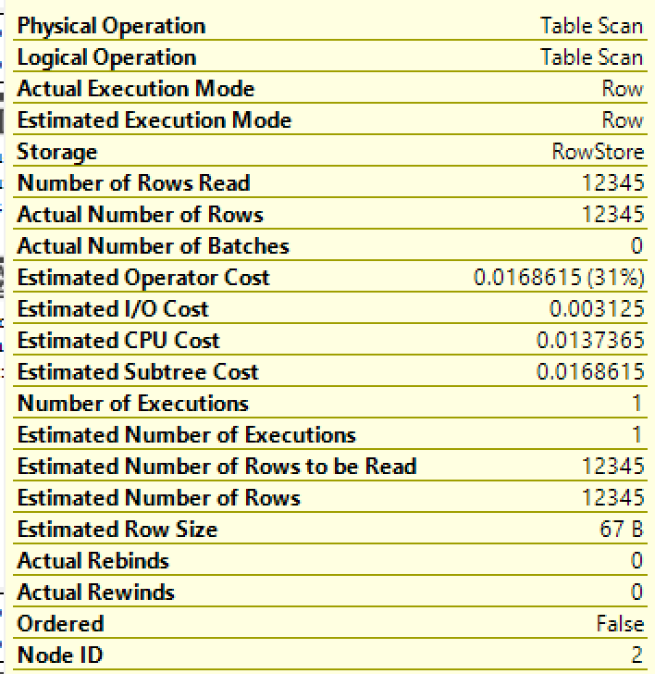
Interleaved Execution (2017)
Interleaved Execution
Compatibility Level 120/130
Compatibility Level 140 or higher
During optimization if SQL Server encounter a read-only multi-statement table-valued function (MSTVF), it will pause optimization, execute the applicable subtree, capture accurate cardinality estimates, and then resume optimization for downstream operations.
Notes:
Parameter-sensitive? GLOBAL query
GLOBAL: Do not capitalize generic terms. Please note that we do not capitalize terms unless they are from the UI or are feature or product names. Please consider lowercasing such terms throughout this document.
GLOBAL: Please avoid using first person (“we”, “I”) Always use “you” or “Microsoft” if that is applicable.
…have a lot of …?

Slide 35
Batch Mode Memory Grant Feedback (2017)
Interleaved Execution
Memory Grant Feedback
Adaptive Joins
Adaptive Query Processing
Batch Mode
When compiling an execution plan, the query engine estimates how much memory is needed to store rows during join and sort operations.
Too much memory allocation may impact performance of other operations. Not enough will cause a spill over to disk.
This feature recalculates memory on first execution and updates the cached plan.
Notes:
Parameter-sensitive? GLOBAL query
GLOBAL: Do not capitalize generic terms. Please note that we do not capitalize terms unless they are from the UI or are feature or product names. Please consider lowercasing such terms throughout this document.
GLOBAL: Please avoid using first person (“we”, “I”) Always use “you” or “Microsoft” if that is applicable.
…have a lot of …?

Slide 36
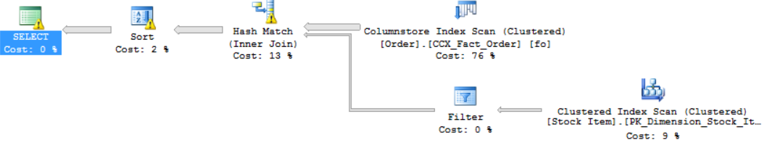
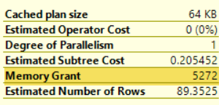
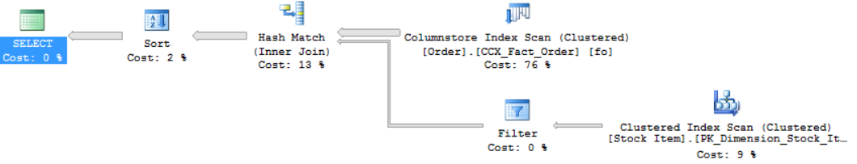
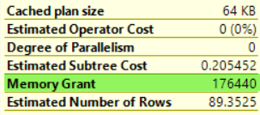
Batch Mode Memory Grant Feedback (2017)
First Execution (Spills detected; feedback generated)
Memory Grant Feedback (Batch Mode)
Second Execution (Memory grant adjusted)
Notes:
Parameter-sensitive? GLOBAL query
GLOBAL: Do not capitalize generic terms. Please note that we do not capitalize terms unless they are from the UI or are feature or product names. Please consider lowercasing such terms throughout this document.
GLOBAL: Please avoid using first person (“we”, “I”) Always use “you” or “Microsoft” if that is applicable.
…have a lot of …?

Slide 37
Row Mode Memory Grant Feedback (2019)
Interleaved Execution
Memory Grant Feedback
Adaptive Joins
Adaptive Query Processing
Batch Mode
Row Mode
Row Mode is just like Batch Mode, but different.
Notes:
Parameter-sensitive? GLOBAL query
GLOBAL: Do not capitalize generic terms. Please note that we do not capitalize terms unless they are from the UI or are feature or product names. Please consider lowercasing such terms throughout this document.
GLOBAL: Please avoid using first person (“we”, “I”) Always use “you” or “Microsoft” if that is applicable.
…have a lot of …?

Slide 38
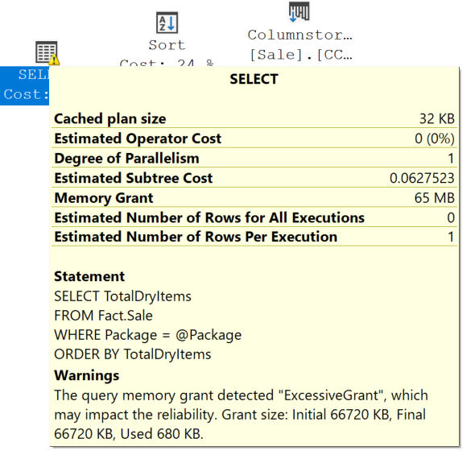
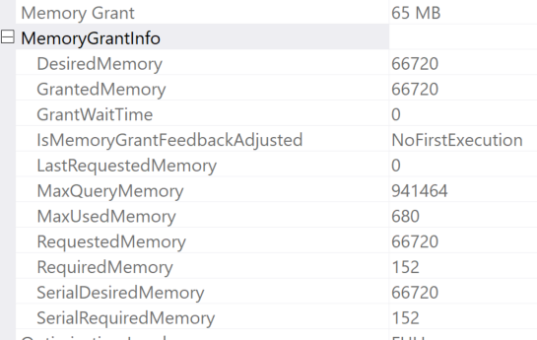
Row Mode Memory Grant Feedback (2019)
Expands on the batch mode memory grant feedback feature by also adjusting memory grant sizes for row mode operators.
Memory Grant Feedback (Row Mode)
Two new query plan attributes will be shown for actual post-execution plans.
Notes:
Parameter-sensitive? GLOBAL query
GLOBAL: Do not capitalize generic terms. Please note that we do not capitalize terms unless they are from the UI or are feature or product names. Please consider lowercasing such terms throughout this document.
GLOBAL: Please avoid using first person (“we”, “I”) Always use “you” or “Microsoft” if that is applicable.
…have a lot of …?

Slide 39
Feedback Persistence (2022)
Interleaved Execution
Memory Grant Feedback
Adaptive Joins
Adaptive Query Processing
Batch Mode
Row Mode
Feedback Persistence
DOP Feedback
CE Feedback
Notes:
Parameter-sensitive? GLOBAL query
GLOBAL: Do not capitalize generic terms. Please note that we do not capitalize terms unless they are from the UI or are feature or product names. Please consider lowercasing such terms throughout this document.
GLOBAL: Please avoid using first person (“we”, “I”) Always use “you” or “Microsoft” if that is applicable.
…have a lot of …?

Slide 40
Feedback Persistence and Percentile (2022)
Problem: Cache Eviction
Feedback is not persisted if the plan is evicted from cache or failover
Solution: Persist the feedback
Persist the memory grant feedback in the Query Store
Record of how to adjust memory is lost and must re-learn
Problem: Oscillating Feedback
Memory grants adjusted based on last feedback
Parameter Sensitive Plans could change feedback
Solution: Percentile-based calculation
Smooths the grant size values based on execution usage history
Notes:
Parameter-sensitive? GLOBAL query
GLOBAL: Do not capitalize generic terms. Please note that we do not capitalize terms unless they are from the UI or are feature or product names. Please consider lowercasing such terms throughout this document.
GLOBAL: Please avoid using first person (“we”, “I”) Always use “you” or “Microsoft” if that is applicable.
…have a lot of …?

Slide 41
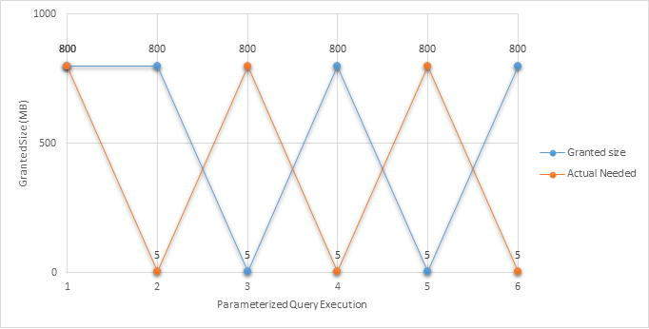
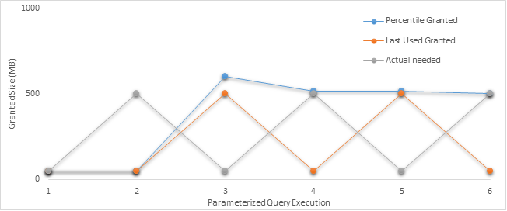
Feedback Persistence and Percentile (2022)
Notes:
Parameter-sensitive? GLOBAL query
GLOBAL: Do not capitalize generic terms. Please note that we do not capitalize terms unless they are from the UI or are feature or product names. Please consider lowercasing such terms throughout this document.
GLOBAL: Please avoid using first person (“we”, “I”) Always use “you” or “Microsoft” if that is applicable.
…have a lot of …?

Slide 42
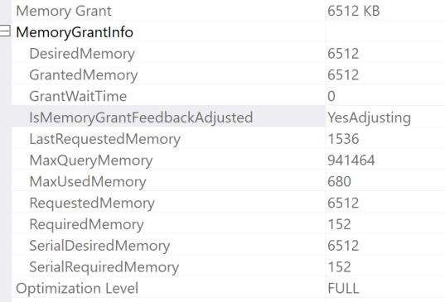
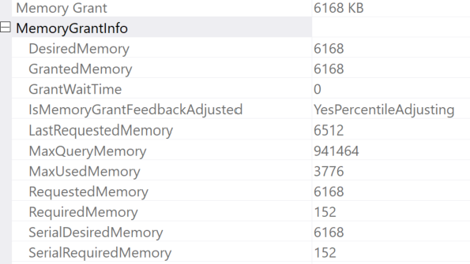
Feedback Persistence and Percentile (2022)
Notes:
Parameter-sensitive? GLOBAL query
GLOBAL: Do not capitalize generic terms. Please note that we do not capitalize terms unless they are from the UI or are feature or product names. Please consider lowercasing such terms throughout this document.
GLOBAL: Please avoid using first person (“we”, “I”) Always use “you” or “Microsoft” if that is applicable.
…have a lot of …?

Slide 43
Cardinality Estimator Feedback (2022)
Interleaved Execution
Memory Grant Feedback
Adaptive Joins
Adaptive Query Processing
Batch Mode
Row Mode
Feedback Persistence
DOP Feedback
CE Feedback
Notes:
Parameter-sensitive? GLOBAL query
GLOBAL: Do not capitalize generic terms. Please note that we do not capitalize terms unless they are from the UI or are feature or product names. Please consider lowercasing such terms throughout this document.
GLOBAL: Please avoid using first person (“we”, “I”) Always use “you” or “Microsoft” if that is applicable.
…have a lot of …?

Slide 44
Cardinality Estimator Feedback (2022)
Problem: Incorrect Assumptions for Cardinality Estimates
The cardinality estimator sometimes makes incorrect assumptions
Solution: Learn from historical CE model assumptions
CE Feedback will evaluate accuracy for repeated queries
Cardinality Estimation Today
CE determines the estimated number of rows for a query plan
CE models are based on statistics and assumptions about the distribution of data
One CE models doesn’t fit all scenarios
If assumption looks incorrect, test a different CE model assumption and verify if it helps
If a CE model assumption does help, it will replace the current plan in cache.
Learn more about CE models and assumptions https://aka.ms/sqlCE
Poor assumptions leads to poor query plans.
Notes:
Parameter-sensitive? GLOBAL query
GLOBAL: Do not capitalize generic terms. Please note that we do not capitalize terms unless they are from the UI or are feature or product names. Please consider lowercasing such terms throughout this document.
GLOBAL: Please avoid using first person (“we”, “I”) Always use “you” or “Microsoft” if that is applicable.
…have a lot of …?

Slide 45
Degree of Parallelism Feedback (2022)
Interleaved Execution
Memory Grant Feedback
Adaptive Joins
Adaptive Query Processing
Batch Mode
Row Mode
Feedback Persistence
DOP Feedback
CE Feedback
Notes:
Parameter-sensitive? GLOBAL query
GLOBAL: Do not capitalize generic terms. Please note that we do not capitalize terms unless they are from the UI or are feature or product names. Please consider lowercasing such terms throughout this document.
GLOBAL: Please avoid using first person (“we”, “I”) Always use “you” or “Microsoft” if that is applicable.
…have a lot of …?

Slide 46
Degree of Parallelism Feedback (2022)
DOP Feedback
Parallelism Today
Parallelism is often beneficial for querying large amounts of data, but transactional queries could suffer when time spent coordinating threads outweighs the advantages of using a parallel plan
Before SQL Server 2019, default value for MAXDOP = 0
With SQL Server 2019, default is calculated at setup based on available processors
Azure SQL Database the default MAXDOP is 8
Current Settings
DOP Feedback will identify parallelism inefficiencies for repeating queries, based on CPU time, elapsed time, and waits
If parallelism usage is inefficient, the DOP will be lowered for next execution (min DOP = 2) and then verify if it helps
Only verified feedback is persisted (Query Store). - If next execution regresses, back to last good known DOP
Notes:
Parameter-sensitive? GLOBAL query
GLOBAL: Do not capitalize generic terms. Please note that we do not capitalize terms unless they are from the UI or are feature or product names. Please consider lowercasing such terms throughout this document.
GLOBAL: Please avoid using first person (“we”, “I”) Always use “you” or “Microsoft” if that is applicable.
…have a lot of …?

Slide 47
Intelligent Query Processing Feature Family
Interleaved Execution
Adaptive Joins
Intelligent Query Processing
Adaptive Query Processing
Batch Mode
Feedback Persistence
Table Variable Deferred Compilation
Batch Mode On Rowstore Indexes
Scalar UDF Inlining
Approximate Query Processing
Approximate Count Distinct
Memory Grant Feedback
Row Mode
Approximate Percentile
Parameter Sensitive Plan Optimization
CE Feedback
DOP Feedback
Optimized Plan Forcing
Azure SQL Database
2017
2019
2022
Notes:
Parameter-sensitive? GLOBAL query
GLOBAL: Do not capitalize generic terms. Please note that we do not capitalize terms unless they are from the UI or are feature or product names. Please consider lowercasing such terms throughout this document.
GLOBAL: Please avoid using first person (“we”, “I”) Always use “you” or “Microsoft” if that is applicable.
…have a lot of …?

Slide 48
Intelligent Query Processing (2019)
Intelligent Query Processing
Table Variable Deferred Compilation
Batch Mode On Rowstore Indexes
Scalar UDF Inlining
Approximate Query Processing
Approximate Count Distinct
Notes:
Parameter-sensitive? GLOBAL query
GLOBAL: Do not capitalize generic terms. Please note that we do not capitalize terms unless they are from the UI or are feature or product names. Please consider lowercasing such terms throughout this document.
GLOBAL: Please avoid using first person (“we”, “I”) Always use “you” or “Microsoft” if that is applicable.
…have a lot of …?

Slide 49
Table Variable Deferred Compilation
Intelligent Query Processing
Table Variable Deferred Compilation
Batch Mode On Rowstore Indexes
Scalar UDF Inlining
Approximate Query Processing
Approximate Count Distinct
Queries that contain table variables will defer the compilation of the execution plan until the first execution of the query statement. This allows the execution plan to use the actual cardinality of the table variable instead of a one row guess.
Notes:
Parameter-sensitive? GLOBAL query
GLOBAL: Do not capitalize generic terms. Please note that we do not capitalize terms unless they are from the UI or are feature or product names. Please consider lowercasing such terms throughout this document.
GLOBAL: Please avoid using first person (“we”, “I”) Always use “you” or “Microsoft” if that is applicable.
…have a lot of …?

Slide 50
Batch Mode on Rowstore Indexes
Intelligent Query Processing
Table Variable Deferred Compilation
Batch Mode On Rowstore Indexes
Scalar UDF Inlining
Approximate Query Processing
Approximate Count Distinct
Allows batch mode execution for analytic workloads without requiring columnstore indexes.
Notes:
Parameter-sensitive? GLOBAL query
GLOBAL: Do not capitalize generic terms. Please note that we do not capitalize terms unless they are from the UI or are feature or product names. Please consider lowercasing such terms throughout this document.
GLOBAL: Please avoid using first person (“we”, “I”) Always use “you” or “Microsoft” if that is applicable.
…have a lot of …?

Slide 51
Scalar User-Defined Function Inlining
Intelligent Query Processing
Table Variable Deferred Compilation
Batch Mode On Rowstore Indexes
Scalar UDF Inlining
Approximate Query Processing
Approximate Count Distinct
Scalar UDFs are automatically transformed into scalar expressions or scalar subqueries that are substituted in the calling query in place of the UDF operator.
Notes:
Parameter-sensitive? GLOBAL query
GLOBAL: Do not capitalize generic terms. Please note that we do not capitalize terms unless they are from the UI or are feature or product names. Please consider lowercasing such terms throughout this document.
GLOBAL: Please avoid using first person (“we”, “I”) Always use “you” or “Microsoft” if that is applicable.
…have a lot of …?

Slide 52
Approximate Query Processing
Intelligent Query Processing
Table Variable Deferred Compilation
Batch Mode On Rowstore Indexes
Scalar UDF Inlining
Approximate Query Processing
Approximate Count Distinct
Approximate Query Processing is a new feature family that will be used to aggregate large datasets where performance is more critical than absolute precision.
Notes:
Parameter-sensitive? GLOBAL query
GLOBAL: Do not capitalize generic terms. Please note that we do not capitalize terms unless they are from the UI or are feature or product names. Please consider lowercasing such terms throughout this document.
GLOBAL: Please avoid using first person (“we”, “I”) Always use “you” or “Microsoft” if that is applicable.
…have a lot of …?

Slide 53
Approximate Count Distinct (2019)
Intelligent Query Processing
Table Variable Deferred Compilation
Batch Mode On Rowstore Indexes
Scalar UDF Inlining
Approximate Query Processing
Approximate Count Distinct
A new aggregate function APPROX_COUNT_DISTINCT that returns the approximate number of unique non-null values in a group.
Notes:
Parameter-sensitive? GLOBAL query
GLOBAL: Do not capitalize generic terms. Please note that we do not capitalize terms unless they are from the UI or are feature or product names. Please consider lowercasing such terms throughout this document.
GLOBAL: Please avoid using first person (“we”, “I”) Always use “you” or “Microsoft” if that is applicable.
…have a lot of …?

Slide 54
Approximate Count Distinct
It returns the approximate number of unique non-null values in a group.
It is designed to provide aggregations across large data sets where responsiveness is more critical than absolute precision.
Guarantees up to a 2% error rate within a 97% probability.
Requires less memory than an exhaustive COUNT DISTINCT operation so it is less likely to spill memory to disk compared to COUNT DISTINCT.
Approximate Count Distinct
SELECT APPROX_COUNT_DISTINCT(O_OrderKey) AS Approx_Distinct_OrderKey
FROM dbo.Orders;
Notes:
Parameter-sensitive? GLOBAL query
GLOBAL: Do not capitalize generic terms. Please note that we do not capitalize terms unless they are from the UI or are feature or product names. Please consider lowercasing such terms throughout this document.
GLOBAL: Please avoid using first person (“we”, “I”) Always use “you” or “Microsoft” if that is applicable.
…have a lot of …?

Slide 55
Approximate Percentile (2022)
Intelligent Query Processing
Table Variable Deferred Compilation
Batch Mode On Rowstore Indexes
Scalar UDF Inlining
Approximate Query Processing
Approximate Count Distinct
Approximate Percentile
An aggregate function APPROX_PERCENTILE
that returns the approximate percentage of unique non-null values in a group.
Notes:
Parameter-sensitive? GLOBAL query
GLOBAL: Do not capitalize generic terms. Please note that we do not capitalize terms unless they are from the UI or are feature or product names. Please consider lowercasing such terms throughout this document.
GLOBAL: Please avoid using first person (“we”, “I”) Always use “you” or “Microsoft” if that is applicable.
…have a lot of …?

Slide 56
Optimized Plan Forcing (2022)
Intelligent Query Processing
Table Variable Deferred Compilation
Batch Mode On Rowstore Indexes
Scalar UDF Inlining
Approximate Query Processing
Approximate Count Distinct
Approximate Percentile
Parameter Sensitive Plan Optimization
Optimized Plan Forcing
Notes:
Parameter-sensitive? GLOBAL query
GLOBAL: Do not capitalize generic terms. Please note that we do not capitalize terms unless they are from the UI or are feature or product names. Please consider lowercasing such terms throughout this document.
GLOBAL: Please avoid using first person (“we”, “I”) Always use “you” or “Microsoft” if that is applicable.
…have a lot of …?

Slide 57
Optimized Plan Forcing (2022)
Query Compilation Today
Query optimization and compilation is a multi-phased process of quickly generating a “good-enough” query execution plan
Query execution time includes compilation. Can be time and resource consuming
To reduce compilation overhead for repeating queries, SQL caches query plans for re-use
Plans can be evicted from cache due to restarts or memory pressure
Subsequent calls to the query require a full new compilation
Notes:
Parameter-sensitive? GLOBAL query
GLOBAL: Do not capitalize generic terms. Please note that we do not capitalize terms unless they are from the UI or are feature or product names. Please consider lowercasing such terms throughout this document.
GLOBAL: Please avoid using first person (“we”, “I”) Always use “you” or “Microsoft” if that is applicable.
…have a lot of …?

Slide 58
Optimized Plan Forcing (2022)
Query Compilation Replay
Version 1 targets previously forced plans through Query Store and Automatic Plan Correction
Uses those previously-recorded CRS to quickly reproduce and cache the original forced plan at a fraction of the original compilation cost
Compatible with Query Store hints and secondary replica support
Stores a compilation replay script (CRS) that persists key compilation steps in Query Store (not user visible)
Notes:
Parameter-sensitive? GLOBAL query
GLOBAL: Do not capitalize generic terms. Please note that we do not capitalize terms unless they are from the UI or are feature or product names. Please consider lowercasing such terms throughout this document.
GLOBAL: Please avoid using first person (“we”, “I”) Always use “you” or “Microsoft” if that is applicable.
…have a lot of …?

Slide 59
Parameter Sensitive Plan Optimization (2022)
Intelligent Query Processing
Table Variable Deferred Compilation
Batch Mode On Rowstore Indexes
Scalar UDF Inlining
Approximate Query Processing
Approximate Count Distinct
Approximate Percentile
Optimized Plan Forcing
Parameter Sensitive Plan Optimization
Notes:
Parameter-sensitive? GLOBAL query
GLOBAL: Do not capitalize generic terms. Please note that we do not capitalize terms unless they are from the UI or are feature or product names. Please consider lowercasing such terms throughout this document.
GLOBAL: Please avoid using first person (“we”, “I”) Always use “you” or “Microsoft” if that is applicable.
…have a lot of …?

Slide 60
Parameter Sensitive Plans (2022)
Parameter Sensitive Plans Today
Parameter-sniffing problem refers to a scenario where a single cached plan for a parameterized query is not optimal for all possible input parameter values
RECOMPILE
Current Workarounds
If plan is not representative of most executions, you have a perceived “bad plan”
OPTION (OPTIMIZE FOR…)
OPTION (OPTIMIZE FOR UNKNOWN)
Disable parameter sniffing entirely
KEEPFIXEDPLAN
Force a known plan
Nested procedures
Dynamic string execution
Notes:
Parameter-sensitive? GLOBAL query
GLOBAL: Do not capitalize generic terms. Please note that we do not capitalize terms unless they are from the UI or are feature or product names. Please consider lowercasing such terms throughout this document.
GLOBAL: Please avoid using first person (“we”, “I”) Always use “you” or “Microsoft” if that is applicable.
…have a lot of …?

Slide 61
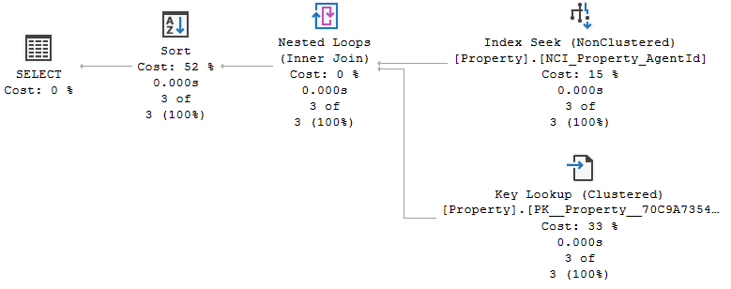
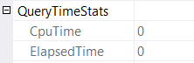
PSP today (Example of Real Estate agent's portfolio)
New compile on Agent 4
This example was borrowed from Pedro Lopes @SQLPedro

Slide 62
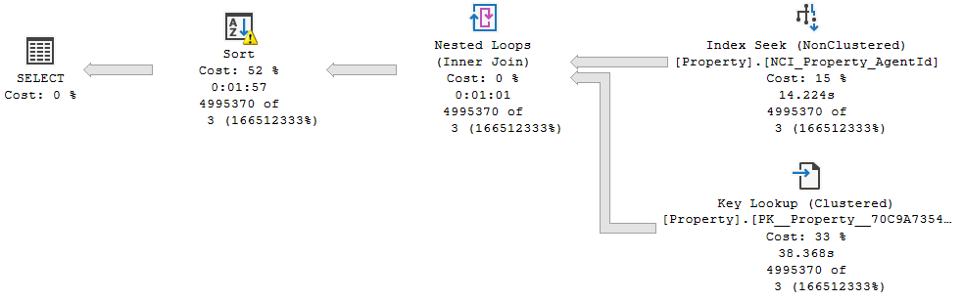
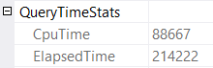
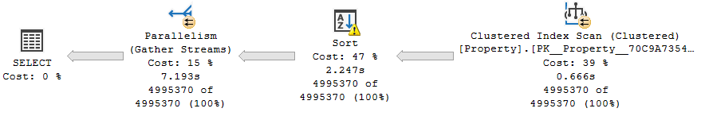
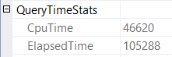
PSP today (Example of Real Estate agent's portfolio)
Using cached plan for Agent 2
New compile on Agent 2

Slide 63
PSP Optimization (2022)
Too many plans generated could create cache bloat, so limit # of plans in cache
Automatically enables multiple, active cached plans for a single parameterized statement
Cached execution plans will accommodate different data sizes based on the customer-provided runtime parameter value(s)
Design considerations
Overhead of PSP optimization must not outweigh downstream benefit
Compatible with Query Store plan forcing
Notes:
Parameter-sensitive? GLOBAL query
GLOBAL: Do not capitalize generic terms. Please note that we do not capitalize terms unless they are from the UI or are feature or product names. Please consider lowercasing such terms throughout this document.
GLOBAL: Please avoid using first person (“we”, “I”) Always use “you” or “Microsoft” if that is applicable.
…have a lot of …?

Slide 64
PSP Predicate Selection (2022)
During initial compilation PSP optimization will evaluate the most “at risk” parameterized predicates (up to three out of all available)
First version is scoped to equality predicates referencing statistics-covered columns; WHERE AgentId = @AgentId
Uses the statistics histogram to identify non-uniform distributions
Notes:
Parameter-sensitive? GLOBAL query
GLOBAL: Do not capitalize generic terms. Please note that we do not capitalize terms unless they are from the UI or are feature or product names. Please consider lowercasing such terms throughout this document.
GLOBAL: Please avoid using first person (“we”, “I”) Always use “you” or “Microsoft” if that is applicable.
…have a lot of …?

Slide 65
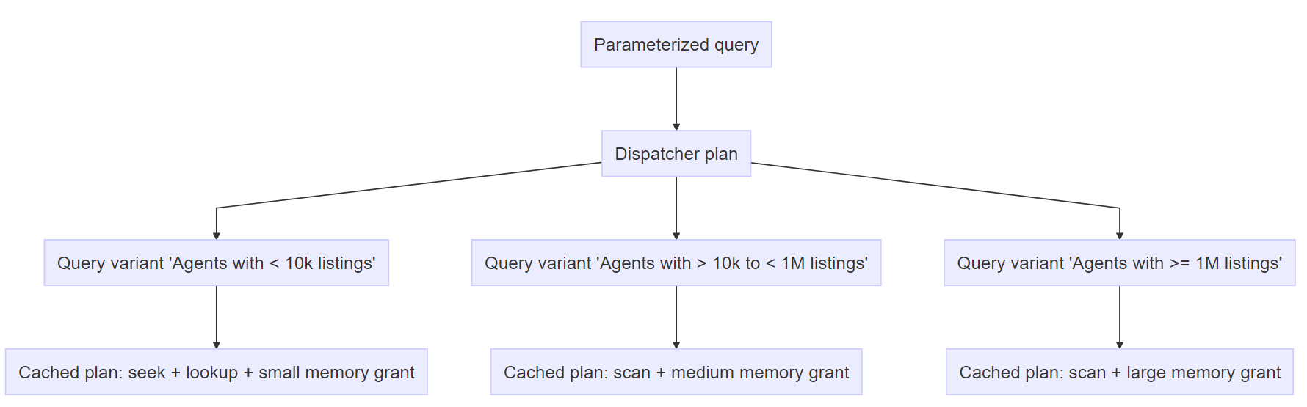
Boundary Value Selection (Dispatcher Plan)
Notes:
For each predicate chosen, we will bucketize them into predicate cardinality ranges based on the runtime cardinality. These plan variants are NOT pre-generated.
Max of 200 plans in QS, 27 plans in cache (up to 3 predicates pwr 3)

Slide 66
Intelligent Query Processing Feature Family
Interleaved Execution
Adaptive Joins
Intelligent Query Processing
Adaptive Query Processing
Batch Mode
Feedback Persistence
Table Variable Deferred Compilation
Batch Mode On Rowstore Indexes
Scalar UDF Inlining
Approximate Query Processing
Approximate Count Distinct
Memory Grant Feedback
Row Mode
Approximate Percentile
Parameter Sensitive Plan Optimization
CE Feedback
DOP Feedback
Optimized Plan Forcing
Azure SQL Database
2017
2019
2022
Notes:
Parameter-sensitive? GLOBAL query
GLOBAL: Do not capitalize generic terms. Please note that we do not capitalize terms unless they are from the UI or are feature or product names. Please consider lowercasing such terms throughout this document.
GLOBAL: Please avoid using first person (“we”, “I”) Always use “you” or “Microsoft” if that is applicable.
…have a lot of …?

Slide 67
Questions?

Slide 68


Slide 69
Microsoft

